Slide 1
Pilot to CoPilot(s)
An Introduction to using copilots with the Microsoft Power Platform
Azure/ATL – July 16, 2024

Slide 2
Agenda
About Me
Context – Microsoft Power Platform
Let’s Build!
Scenario
Power App
Power Automate
Power Pages
Resources

Slide 3
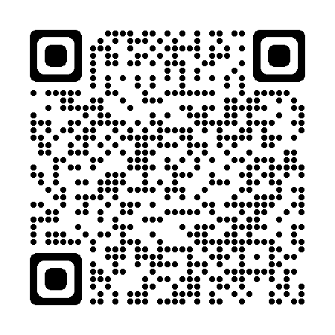
About Me
Formed Flamm Consulting in 2000, serving clients in extractive, manufacturing, services, and finance verticals
Presented to local user groups, SQL Saturday events, and other community conferences
SQL Server, Azure Analytics, and Azure AI certifications; also AWS Cloud Practitioner
Interests include developer technology (Python, .NET) and PowerShell/CLI automation
E-Mail: eric@flammconsulting.com
LinkedIn: www.linkedin.com/in/ericmflamm/

Slide 4
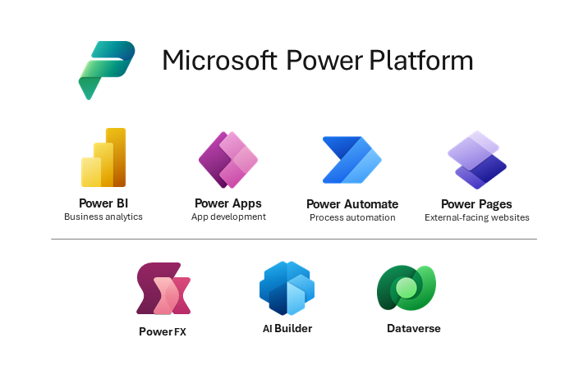
Context-Microsoft Power Platform
Notes:
I won’t be addressing Power BI, Power FX, or AI Builder today. I do want to provide a bit more background on Dataverse since it’s essential to Copilot operation and is a bit of an unknown.

Slide 5
Context-Microsoft Dataverse
2016: Microsoft launches Dynamics 365, moving ERP to Azure. To support the application, the Common Data Model was included to store and manage business entities.
Later in 2016, Microsoft announced the Common Data Service, enabling data storage and modeling with management built into Office applications.
In 2021, the Common Data Service was renamed Dataverse, providing cloud storage for application data and integration with Microsoft 365 (Office) and Dynamics 365.
Notes:
We’ll see the Dataverse in action during the demo. In addition to cloud data storage, Dataverse can provide virtual access to data stored elsewhere, including Azure SQL, Microsoft OneDrive, and SharePoint online.

Slide 6
Context-Dynamics Environments
An environment is a container to manage data, app, chatbots, and flows.
With a premium license, Managed Environments give administrators more control and insight into resource usage. This feature is disabled in Developer accounts.
Environments are managed through the Admin portal (admin.powerplatform.Microsoft.com).
Environments can be 1 of several types:
Developer
Production
Trial
Sandbox
Your license status controls which kinds of environments you can create; 30-day free trials are available.
Environments take time to prepare.
Notes:
Create and manage environments in the Power Platform admin center - Power Platform | Microsoft Learn
https://learn.microsoft.com/en-us/power-platform/admin/create-environment?wt.mc_id=ppac_inproducthelp_ghp

Slide 7
Let’s Build - Scenario
An upcoming user group conference has just announced its Call for Speakers. Candidates are requested to create an account on Sessionize.com, enter their professional bio, and provide 1 or more suggested sessions for the conference.
The organizers want to collect and review the session proposals without deploying a lot of overhead for database management, web hosting, etc. Let’s see if Copilot can help us build a collection of resources to facilitate conference management.
In order to get the ball rolling, the organizers have requested that the candidates provide the following information in an e-mail:
Session Title:
Speaker Name:
Speaker E-Mail:
Sessionize URL:
Suggested Track:
Session Level:
So we need to capture this information and store it for processing and analysis

Slide 8
Demo-PowerApps Copilot
Prompt | Response | Action
I want an app to collect information about Conference Session Proposals. The records should include the Session Title, the Speaker's Name, the Speaker's E-Mail, and a Sessionize URL. | Copilot creates a Dataverse Table with 4 text fields – the e-mail and URL fields are identified as such to support input validation and downstream applications | Review the table design.
Add a choice column for Session Level: Intro, Intermediate, Advanced | Copilot adds the field with 3 choices available | Test the choice column by selecting the pull down menu
Add a choice column for Suggested Track: Developer, Admin, Analytics, Professional Development | Copilot adds the field with 4 choices available | Test the choice column by selecting the pulldown menu. Click the Save and Open App button to prompt Copilot to continue

Slide 9
Demo-PowerApps
Action | Response | Explore
Run the app as created by clicking the Run button | App is displayed in browser view | Tablet and Phone views
Add a new session by clicking the New Icon (+) | Session is added to session list | Click X to exit app preview mode
Experiment with adding new screens with different templates | CoPilot seems to struggle with my prompts | Add a new screen manually and see if CoPilot can populate it
Exit the App | Save when prompted | Use the 3-dot menu to view App Details
Edit the App. Add 2 buttons labeled Accept and Decline in Form1 | CoPilot adds the buttons, but they need to be moved | Move them to bottom of form.
Edit the App. Add a new screen using the sidebar template | CoPilot was not able to carry out this instruction, so let’s Move ON! | Edit app manually

Slide 10
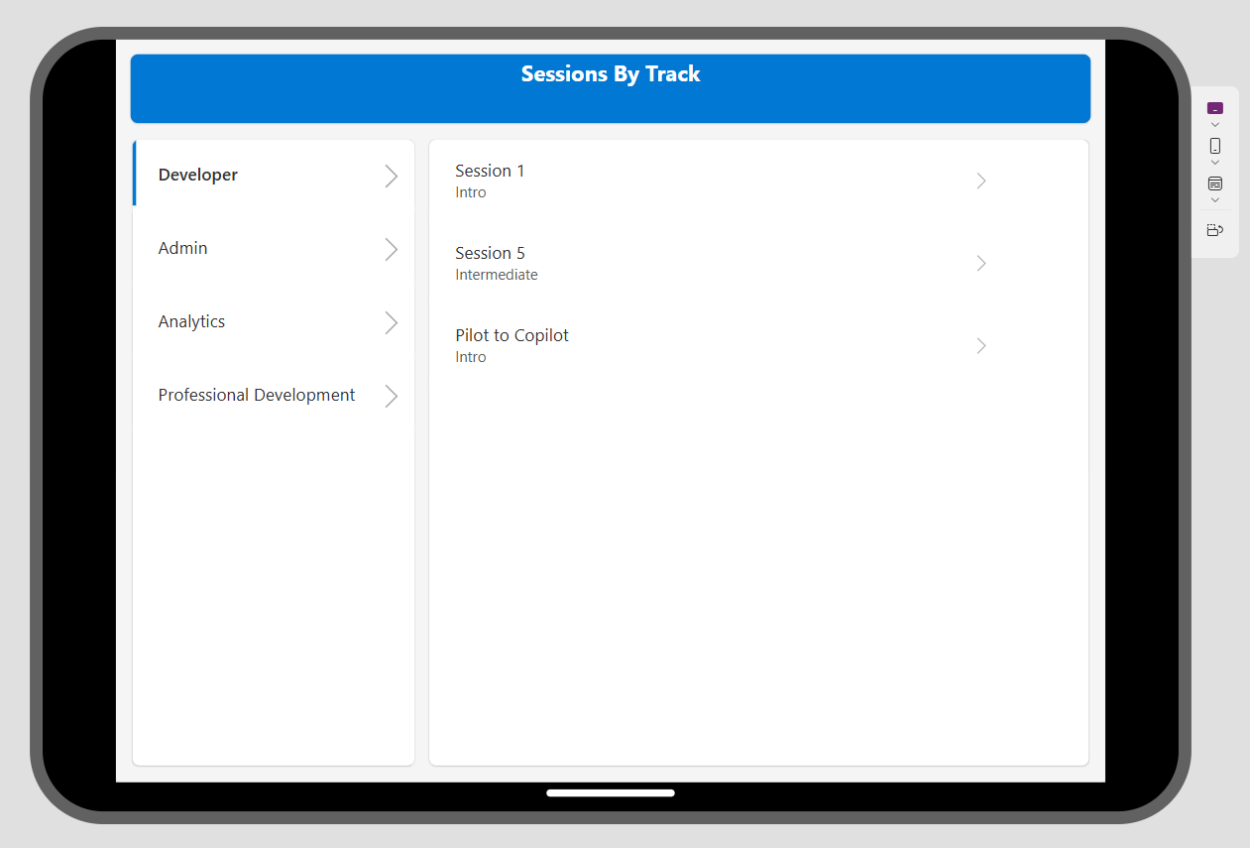
Add a Sessions By Track View
Not able to do this with CoPilot…

Slide 11
Scenario - PowerAutomate
Now we want to create a PowerAutomate flow which will send an e-mail to the Speaker candidate when the committee decides to Accept or Decline their proposal.
Start by logging into make.powerautomate.com
Switch to the AZATL environment
Try this prompt: Send an e-mail triggered by the SessionProposals app is pressed
Click Next. Check the connection to Outlook that PowerAutomate will use.
Click Create Flow
Click the Send an email action to edit the parameters
Use the lightning bolt to connect to data from the PowerApp (may be none at first)
Unfortunately, at present CoPilot doesn’t seem to do much in PowerAutomate. There is also some sort of policy issue which I have to resolve,so let’s move on to PowerPages.

Slide 12
Scenario – Power Pages
The committee wants to share the submitted sessions with a broader audience. Let’s see if CoPilot can help us build a website with PowerPages to display the submitted session data.
https://make.powerpages.microsoft.com/
CoPilot can help in a very limited way by starting the wizards which drive PowerPages development. However, once you need to edit the page contents or connect with data, it seems like you need to interact directly with PowerPages.

Slide 13
Observations
Copilots have been added to the Power Platform applications
Each application seems to be at a different stage of development – PowerApps is able to take advantage of the Copilot experience today, but PowerAutomate and PowerPages are works-in-progress
In some cases, Copilot surfaces a Bing search result, which may connect to Microsoft Learn or other valid resources, but can also pick up out-of-date or just plain incorrect information.
The Dynamics/PowerPlatform licensing environment is confusing (at least to me), and creating an environment suitable for production workloads is likely to require a fair amount of effort (and there doesn’t seem to be a Copilot to help out).
On the other hand, using Copilot to get started with some one-off applications with simple data models could produce useful results in a short time.

Slide 14
Useful Links for PowerPlatform/Copilot
Power Platform—Free Trials | Microsoft Power Platform | https://www.microsoft.com/en-us/power-platform/try-free
Power Platform on Microsoft Learn | Microsoft Learn | https://learn.microsoft.com/en-us/training/powerplatform/?WT.mc_id=webupdates_GEP_Powerplatform-web-wwl
Summary and resources - Training | Microsoft Learn | https://learn.microsoft.com/en-us/training/modules/introduction-power-platform/13-summary-resources?source=learn

